Slide 1
Pharmacy Technician and Support Worker Apprenticeship Training Overview – Lister Hospital
Pharmacy Technician Specialist – Education and Training: Chloe Chapman

Slide 2
Contents
Where are we?
Our Trust
Where do our pharmacy staff work
Apprenticeship programs:
    Pre-registration Trainee Pharmacy Technicians
    Pharmacy Support Workers - Level 2 Apprenticeship
    Science Manufacturing Technician Apprentices
    Science Manufacturing Process Operative – Level 2 Apprenticeship
Support from specialist staff
Our designated Educational Supervisor
Contact Information

Slide 3
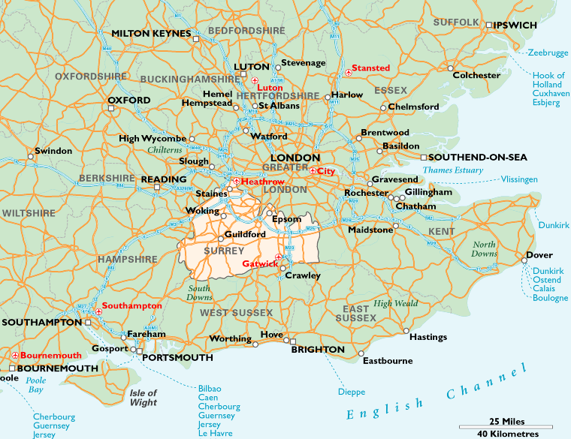
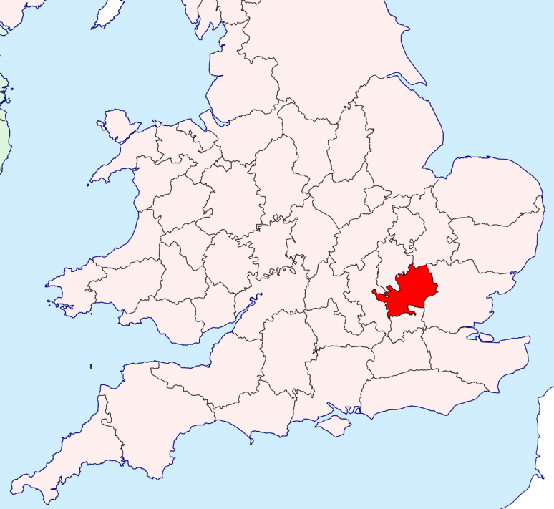
Where are we?
Hertfordshire
Stevenage
Semi rural location close to Stevenage town centre.
Close to historic towns – St Albans, Hitchin and Hertford
20 Minutes from central London, regular trains to Kings Cross and St Pancras
Easy access to London, Cambridge, Oxford and M1, M25 and M11

Slide 4
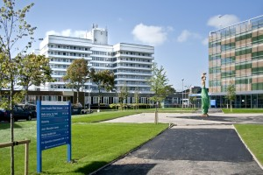

East and North Hertfordshire NHS Trust – Lister Hospital
Hertfordshire & West Essex Integrated Care System (ICS)
  Lister Hospital
  Princess Alexander Hospital
  Watford General Hospital
  All PCN’s
  Community Trusts
  Mental Health Trusts
FUN FACTS
  Named after Joseph Lister
  Pioneer of antiseptics in surgery
  Listerine mouthwash
  Listeria genus
730 bed Acute Trust
Renal specialist centre &
dialysis unit
Urology – robotic surgery
160 pharmacy staff
60 Pharmacists

Slide 5
Where do our pharmacy staff work?
Dispensary
Ward based – patient facing
Pharmacy hubs – providing a dispensing service at ward level
Aseptics – includes making chemotherapy dose
Patient safety
Procurement
Stock distribution
Homecare
Clinical trials
IT and electronic prescribing
Antimicrobials
Education

Slide 6
Apprenticeship programmes – PTPT part 1
Pre-registration Trainee Pharmacy Technicians(PTPTs) 2 year duration:
We currently have 8 PTPTs
Year 1 focus includes:
-labelling and dispensing all types of prescriptions -Rotations to different areas of the department
-In-house patient counselling course
Year 2 focus includes:
-Accuracy checking accreditation -Medicines Management competencies
Apprentices will attend study days 10 study days per year and monthly online forums
Set evidences gathered throughout the course, 3 exams per year

Slide 7
Apprenticeship programmes – PTPT part 2
Support provided:
-In-house support provided: 20% off the job hours, this means for a full time member of staff equivalent of 7.5hours per week paid learning time.
-Fortnightly meetings with in-house educational supervisor
-12 weekly reviews with education provider
On completion candidates will be able to register with the General Pharmaceutical Council. Eligible to apply for a permeant post as a Pharmacy Technician
Prerequisites: Must have GCSE grade 4 or above (or equivalent) in Maths, Science and English Language

Slide 8
Apprenticeship programmes – Pharmacy Support Worker
Pharmacy Support Worker Level 2 apprenticeship 15 month duration:
1 study day per month
Evidence is gathered in the workplace using written accounts, reflections and observations
On completion candidates will meet General Pharmaceutical Council requirements, this is essential for this job role.
In-house support provided: 20% off the job hours, this means for a full time member of staff equivalent of 7.5hours per week paid learning time.
Prerequisites: candidate should have GCSE grade 4 or above (or equivalent) in Maths, Science and English Language

Slide 9
Apprenticeship programmes - SMT
Science Manufacturing Technician Apprentices (SMTs) 2 year duration:
We currently have 2 SMT Apprentices
This is a new course where candidates gain a qualification whilst working in aseptics, one of the main roles in this area is the production and supply of chemotherapy doses.
1 study day per week, assignments and evidences gathered in the workplace.
On completion candidates will be able to register as a Science Manufacturing Technician. Eligible to apply for a permeant post as a Science Manufacturing Technician
Prerequisites: Must have GCSE grade 4 or above (or equivalent) in Maths, Science and English Language

Slide 10
Apprenticeship programmes - SMPO
Science Manufacturing Process Operative (SMPO) 15 month duration:
This is a new apprenticeship where candidates gain skills and knowledge whilst working in aseptics, one of the main roles in this area is the production and supply of chemotherapy doses.
2 study days per month
Evidence is gathered in the workplace using written accounts, reflections and observations
On completion candidates will meet General Pharmaceutical Council requirements, this is essential for this job role.
In-house support provided: 20% off the job hours, this means for a full time member of staff equivalent of 7.5hours per week paid learning time.
Prerequisites: candidate should have GCSE grade 4 or above (or equivalent) in Maths, Science and English Language

Slide 11
Support from specialist staff at Lister
24 Medicines Management Pharmacy Technicians (some split role)
38 registered Pharmacy Technicians
In-house Medicines Management and Patient Counselling courses
Education and Training Specialist Technician
Specialist/lead roles including:
-Clinical Trails
-Aseptics
-Procurement
-Medicines
Management
-Patient Safety
-Antimicrobials
-IT and Electronic Prescribing
-Homecare
-Stock Distribution

Slide 12
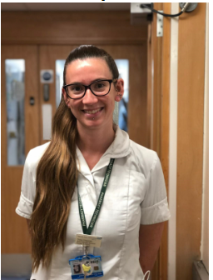
Pharmacy Technician Specialist – Education and Training
Chloe Chapman
NVQ & BTEC Level 3 Pharmacy Services 2011
Accuracy Checking Pharmacy Technician
qualification 2013
Accreditation in Medicines Management 2015
NVQ assessor 2017
Educational Supervisor via University of East Anglia 2018
Education and Training Specialist Technician

Slide 13
Contact information
For further information or to arrange a visit please contact
  Chloe Chapman via email chloechapman@nhs.net
Trust website https://www.enherts-tr.nhs.uk/services/pharmacy/ for more information
Twitter @pharmacyENHT for Trust news and events

